Slide 1

Workflow thoughts
Andrew Grimshaw

Slide 2

Thoughts
There is a rich literature in workflow, workflow systems, workflow languages, etc. (There are even workshops)
Can either choose an existing solution (and anger everyone else), or create a new one.
Must clearly delineate between workflow/orchestration languages, implementations, and basic specification
OGF best served by simplicity – see success of JSDL
  Many existing systems are very capability rich
  Want something that is extensible – but captures just the simple part

Slide 3
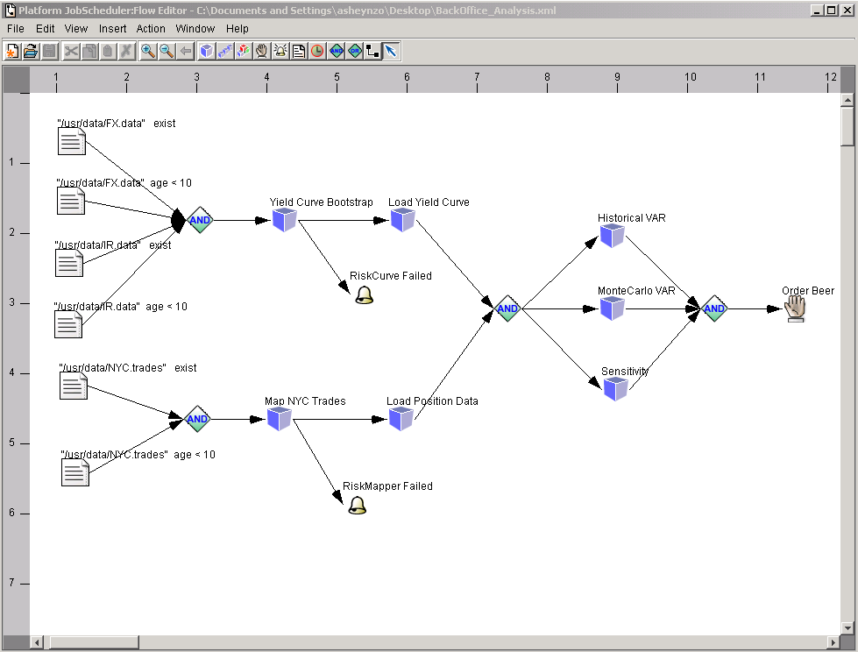
LSF Workflow Editor

Slide 4
Proposal
OGF/OGSA stay away from language and API specification
Create a simple Workflow description language (WFDL) that focuses on simplicity (everything else is out of scope) and that builds on (assumes) that the vertices are JSDL documents.
Don’t try for a WFDL that can do everything!!!!
Ensure that there are reasonable mappings from many existing systems to WFDL, i.e., it is possible to express some of their behavior in WFDL.
Others can build tools to construct and execute WFDL documents. The spec is silent on control structures, at most once semantics, and stuff like that.
Reuse as much proven spec as possible

Slide 5
Model
WFDL’s are XML documents that describe directed graphs
  Vertices (nodes) and edges described
Nodes are either WFDL documents, or JSDL (or wrapped JSDL) documents
Nodes have labeled inputs and outputs
Edges connected outputs from one node to inputs on other nodes.
Question: Can the graph be annotated with information or initial “tokens”?
NB: Not data flow. Some “outputs” may simply be that an event has occurred.

